Slide 1
超越学科界限的认知基础 Transdisciplinary Cognitive Foundation Arts, Skills and Human Talent Week 11
Ben Koo
November 23, 2020

Slide 2
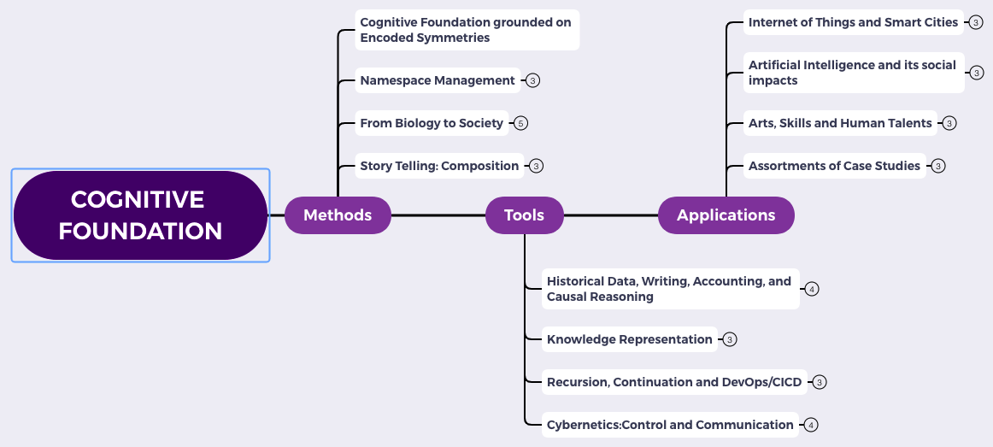
Content Themes for the semester
Overview
Namespace Management
Biology, Physics, Math, Code is Law, and Society
Story Telling, Functions/Metaphors/Analogies
Writing, Accounting, Historical Data and Temporal Reasoning
Knowledge Representation in Wiki and Files
Recursion and Continuation (DevOps/CICD)
Midterm Reports by Students
Cybernetics (Control and Communication)
Smart City and Internet of Things
Artificial Intelligence and its Social Impacts
Arts/Skills/Human Talents in the Digital Era
Student proposed Application Topics
Rehearsal
Final Reports and Celebration

Slide 3

Logic Model
Logic Model
Context: We talked about AI and Cybernetics and how they have transformed cognitive foundations
Goal: Show how Big Data re-defines arts, skills and the novelty of human talent
Criteria:
Languages as Lenses/Filters
Is there a unifying metric for artistic value and novelty?
The “why” of a unifying metric?
Output: Arts, skills and talents as a framework of value judgements
Process: Presenting linguistic evidence/habits of value judgement
Input:
Monad and Meta Type Theories
Language models as data models
Varying linguistic models for different scales of applications
A well-defined set of Actions and iterative Branching Strategies
A Roadmap of composable activities
Sequencing and timing conditions
Explicitly state dependencies and resource requirements
Boundary Conditions: audience agrees with the fact that data/algorithms drive modern human activities

Slide 4
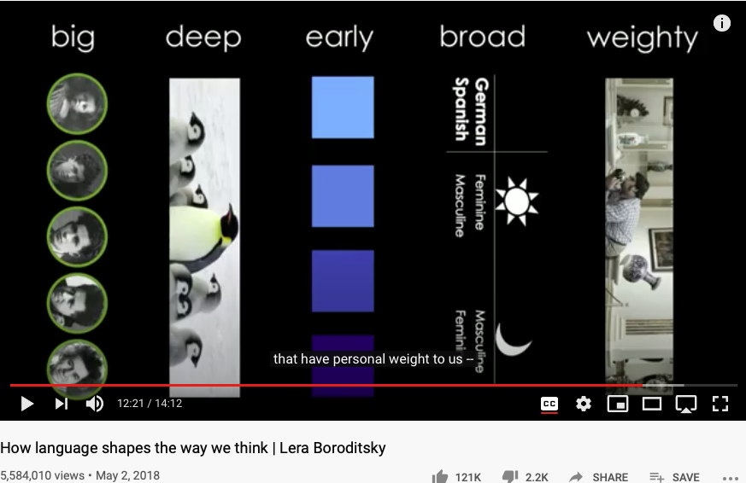
Language choices influence your Cognitive Foundation
Huawei VP Mr. Yang Shaoqing
https://youtu.be/RKK7wGAYP6k

Slide 5
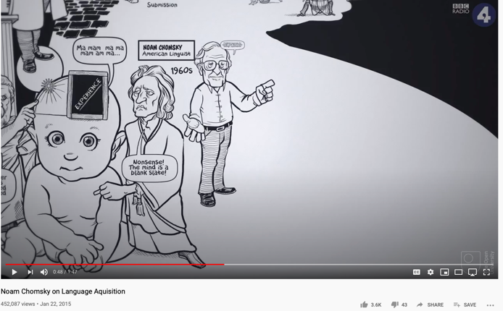
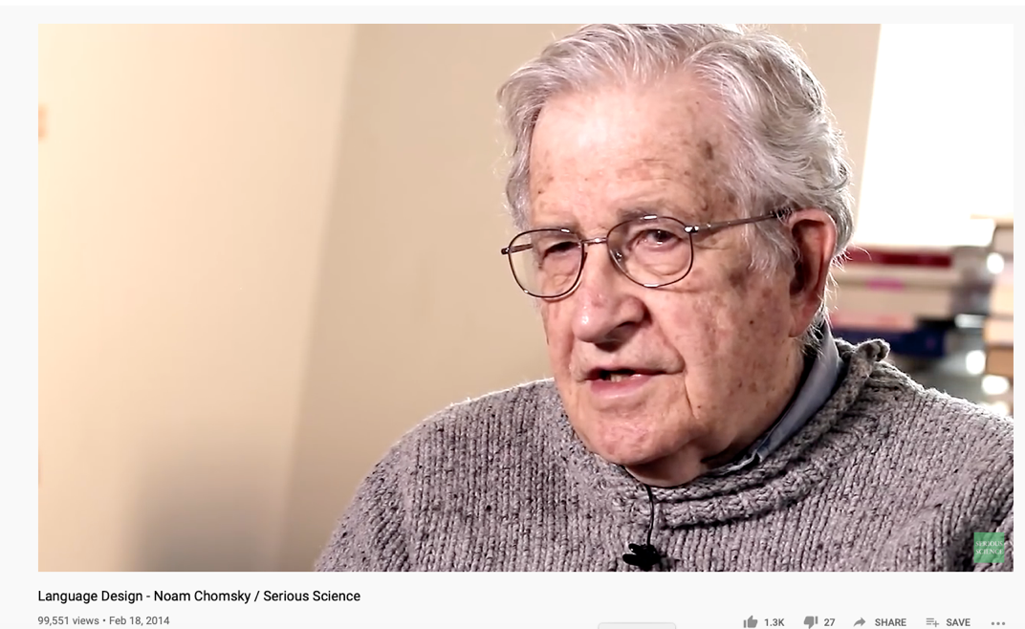
Chomsky’s Universal Grammar
Also see: Are you smarter than a Chimp?
https://youtu.be/7Cgpfw4z8cw?t=48
Language Design - Noam Chomsky / Serious Science

Slide 6
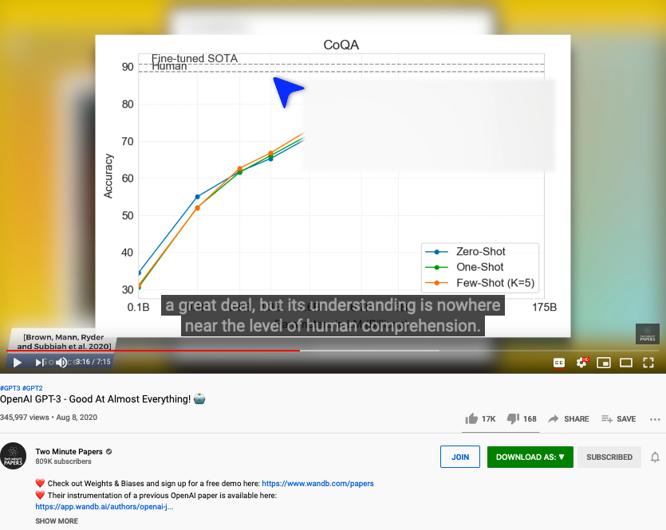
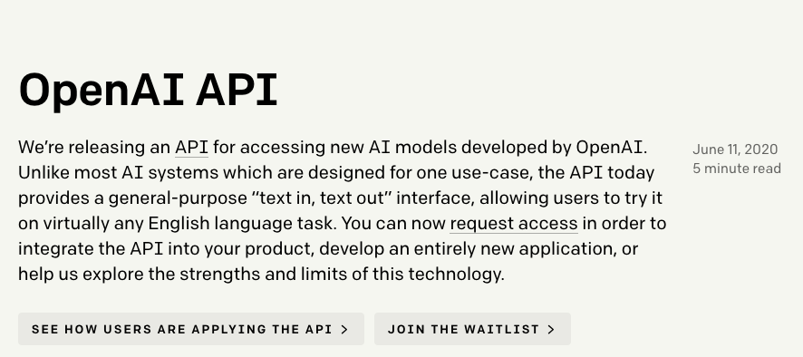
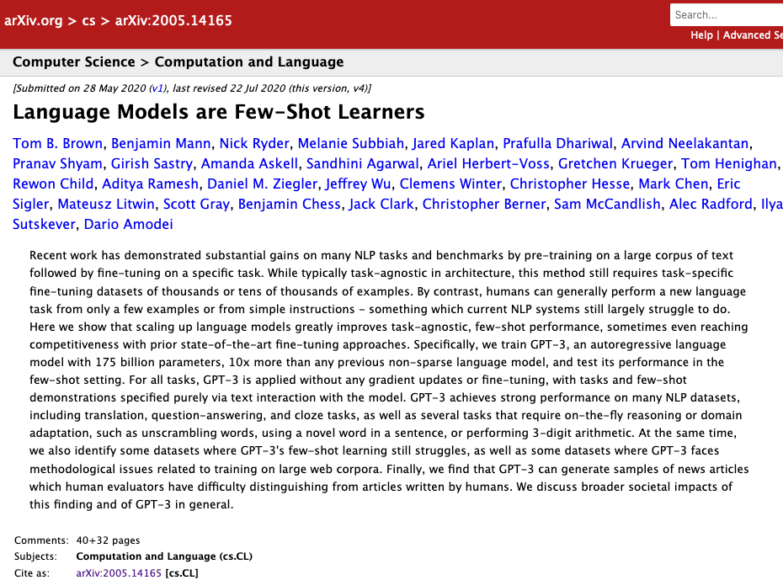
GPT-3: The State of the Arts in Big Data
Huawei VP Mr. Yang Shaoqing

Slide 7
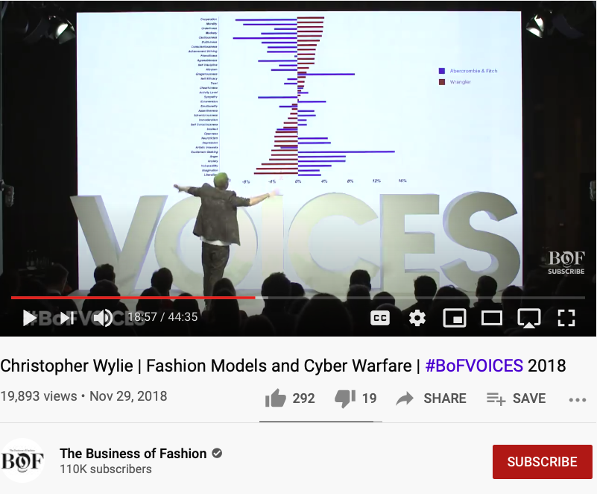
Aesthetics and Value Judgements amplified by Big Data
Huawei VP Mr. Yang Shaoqing
RICH 70 Tsinghua SEA Cloud Forum, Sep 14, 2020
H. E. Bambang Brodjonegoro,
Minister of Research & Technology, Indonesia

Slide 8

DevOps Goals for Governance
Notes:
1. 對稱性是底層的不變性
2. 在Cyberspace上，數據、操作數據的方式、操作數據的基礎架構，是資產的根本
3. 邏輯模型是凝聚群體意識的有效框架
4. Devops 能夠高效實現不同規模的Logic Model, 藉由（不同層次）數據可視與可控

Slide 9
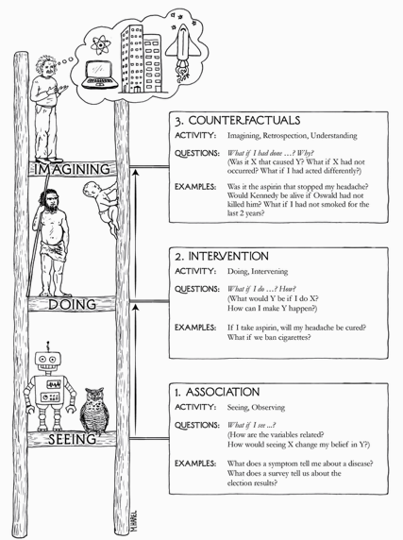


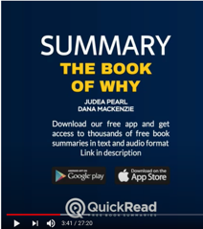
“The” Book of Why

Slide 10

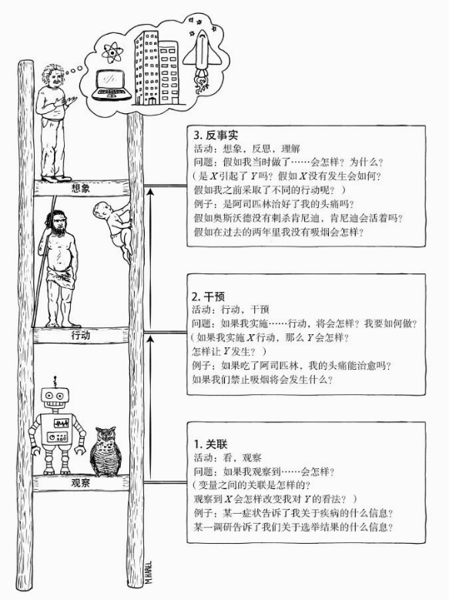
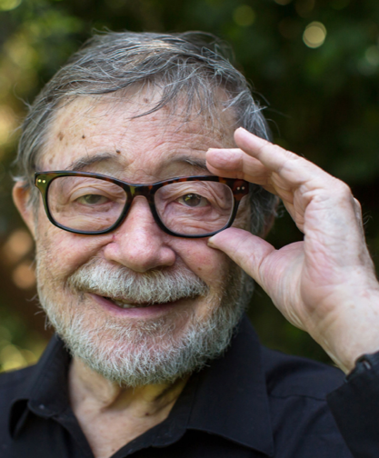
The Cognitive Ladder in the Age of Data
Why
How
What
https://www.quantamagazine.org/to-build-truly-intelligent-machines-teach-them-cause-and-effect-20180515/

Slide 11
What, How and Why
What/Association marks data content (naming objects)
How/Intervention demonstrates active intent (human free will)
Why/Counterfactuals checks on associations by breaking symmetry
Branching on the assumptions/contextual groundings
It is the simplicity of data types (associations) that enables scale
All data types share the same basic type (association/arrow/label/named object)

Slide 12
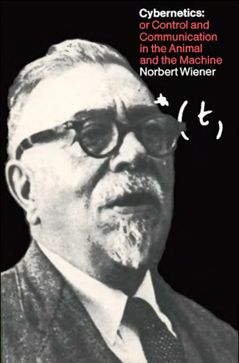
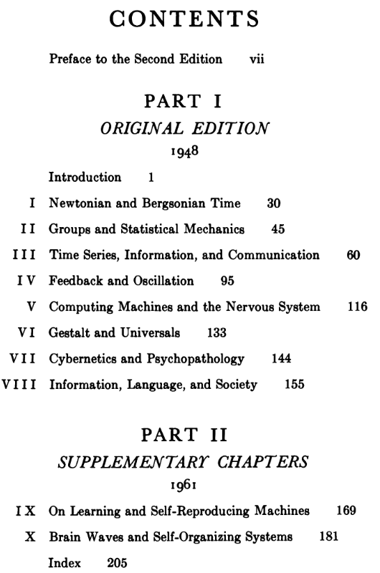
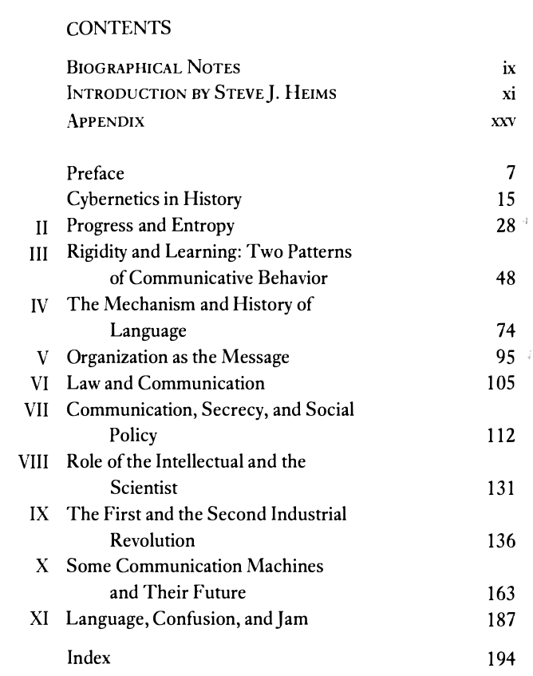

Wiener’s Framing of Societal Values

Slide 13


Slide 14
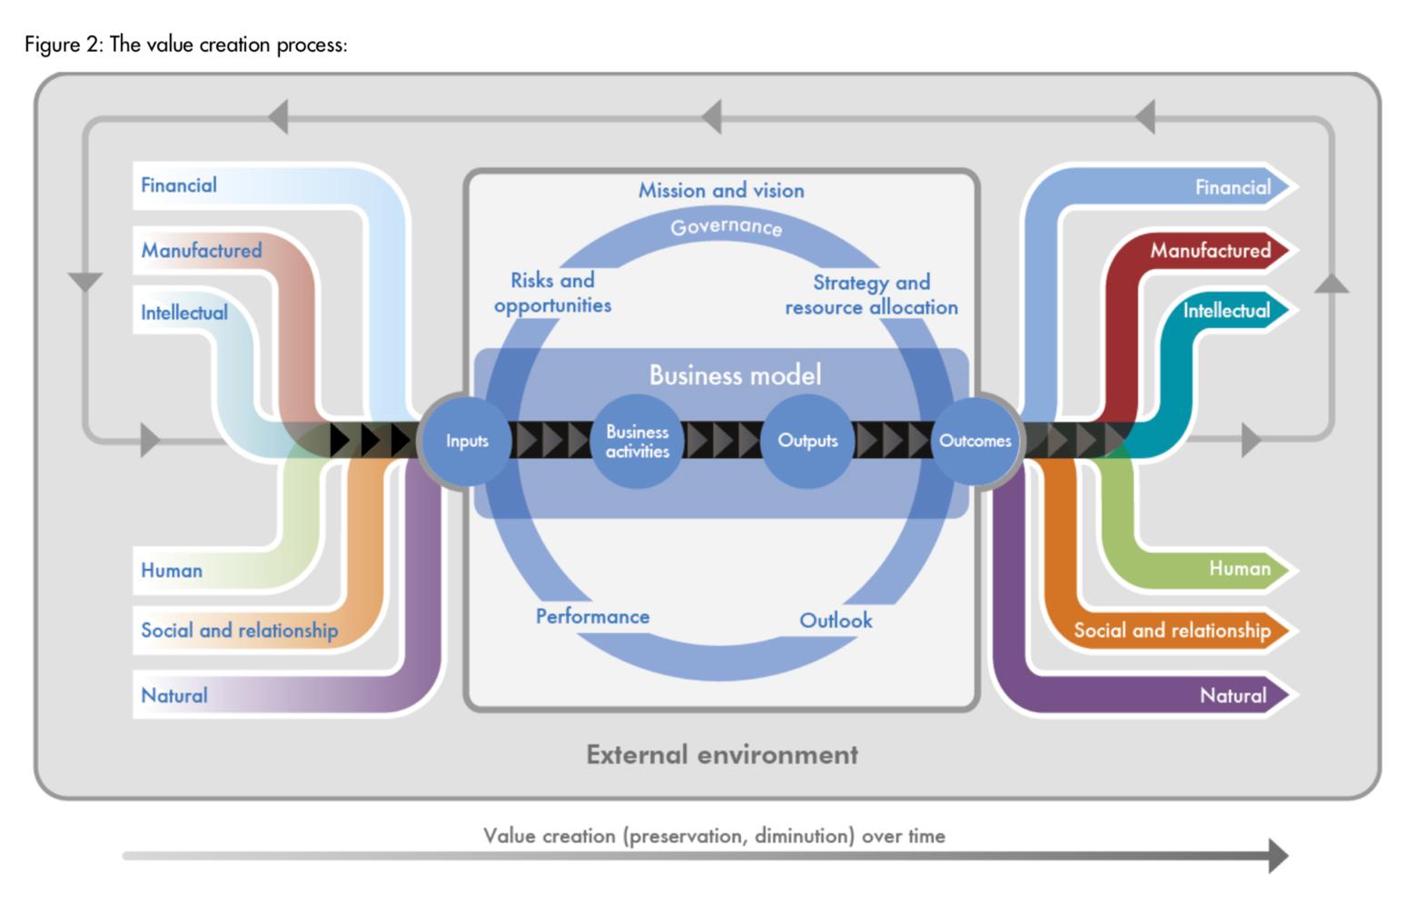

Accountants’ Value Proposition
The International
Integrated Reporting
Framework
Dec. 2013
Notes:
“historian James Aho linked double-entry bookkeeping to the ancient art of rhetoric,”
Excerpt From: Jane Gleeson-White. “Double Entry.” Apple Books.

Slide 15


Thomas S. Kuhn: The Structure of Scientific Revolutions
c
Thomas Samuel Kuhn (/ˈkuːn/; July 18, 1922 – June 17, 1996)
https://en.wikipedia.org/wiki/Thomas_Kuhn

Slide 16
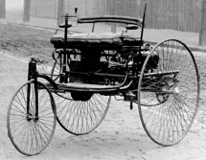
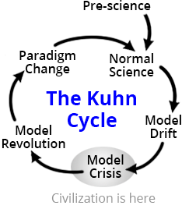
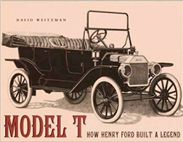
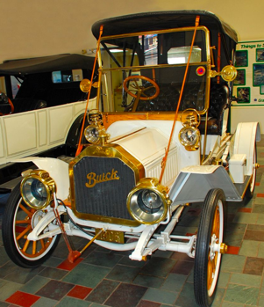
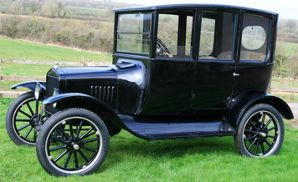
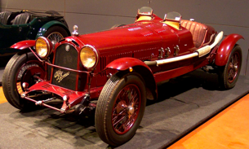
Kuhn Cycle as the Structure
Product Life Cycle | Kuhn Cycle
Artifacts | Pre-Science
Popular Product | Normal Science
Varying Modifications | Model Drift
Product Crisis | Model Crisis
New Product Developed and Released | Model Revolutioon
New Product Adopted as the Popular Product | Paradigm Change
https://www.quora.com/What-was-the-first-car-in-the-world
1908 BuickModel10
Convertible
1917–23 Ford Model T Center Door Sedan
1929 Alfa Romeo 6C
Image Source: https://www.thwink.org/sustain/glossary/KuhnCycle.htm
Notes:
https://www.google.com/imgres?imgurl=https%3A%2F%2Fmodeltfordfix.com%2Fwp-content%2Fuploads%2F2018%2F02%2F1910-model-10-uick-touring.jpg&imgrefurl=https%3A%2F%2Fmodeltfordfix.com%2Fthe-competition-the-model-t-ford-in-the-marketplace-part-1%2F&tbnid=_HHnH2q6ArJyZM&vet=12ahUKEwj02MyOzevnAhVcgUsFHYqRCfAQMygaegQIARA8..i&docid=oOY6Ah05bNLqDM&w=700&h=525&q=General%20Motors%20competition%20to%20Model%20T&ved=2ahUKEwj02MyOzevnAhVcgUsFHYqRCfAQMygaegQIARA8#h=525&imgdii=dyFbBK_MkjEQ2M:&vet=12ahUKEwj02MyOzevnAhVcgUsFHYqRCfAQMygaegQIARA8..i&w=700

Slide 17
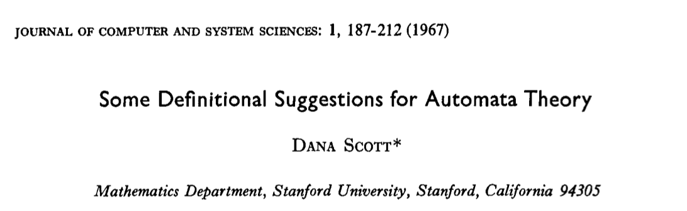
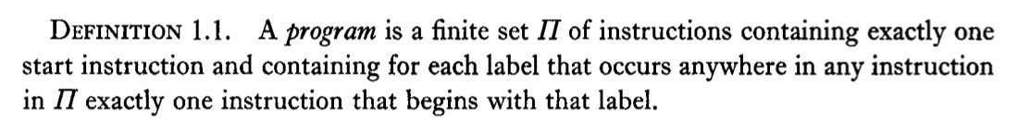
Definitional Suggestion for Computing Science

Slide 18
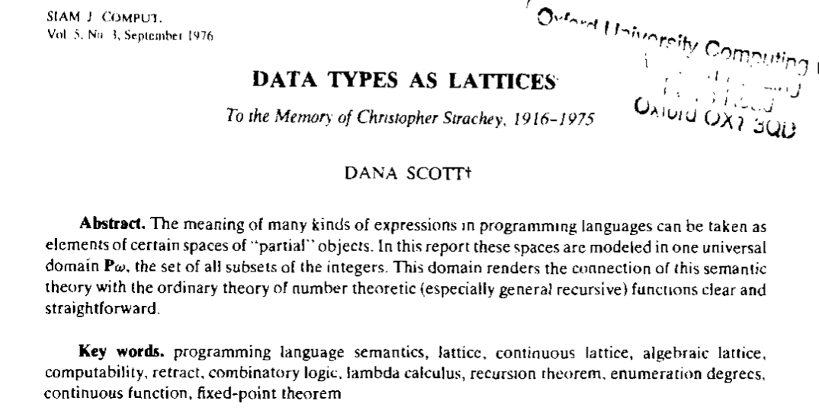
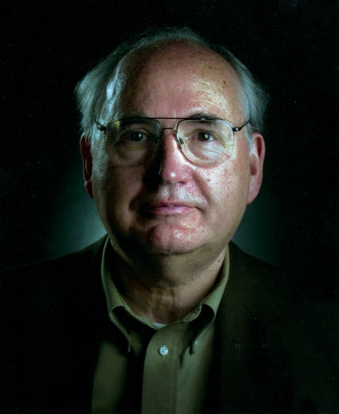
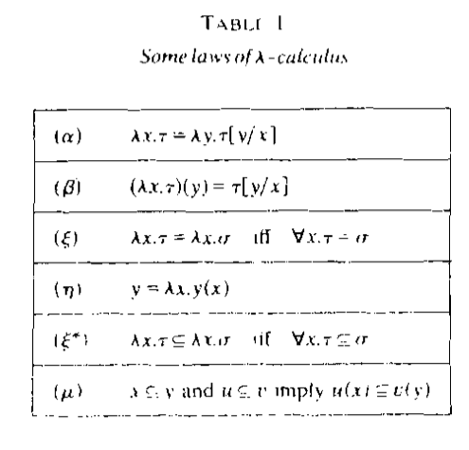
All meaningful expressions can be modeled as $𝒫ω$
Prof. Dana Stewart Scott
Image Source: Britannica

Slide 19
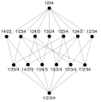
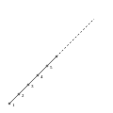
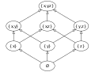
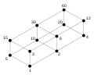
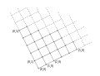
What is a Lattice?
Pic. 1: Subsets of {x, y, z}, under set inclusion. The name "lattice" is suggested by the form of the Hasse diagram depicting it.
Pic. 2: Lattice of integer divisors of 60, ordered by "divides".
Pic. 3: Lattice of partitions of {1, 2, 3, 4}, ordered by "refines".
Pic. 4: Lattice of positive integers, ordered by ≤.
Pic. 5: Lattice of nonnegative integer pairs, ordered component wise.
Source of Images and Text : https://en.wikipedia.org/wiki/Lattice_(order)

Slide 20
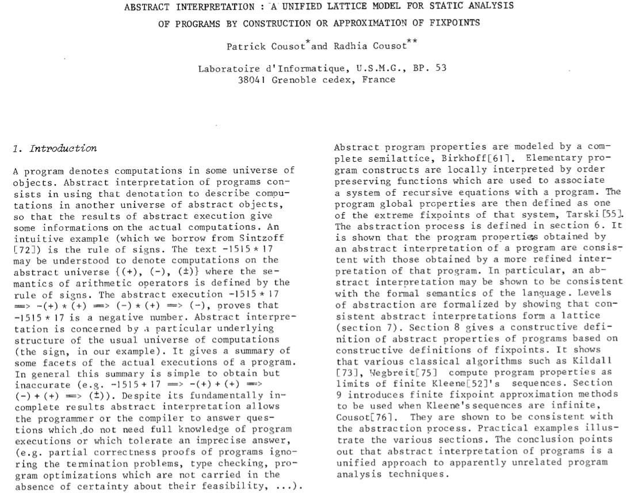
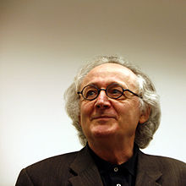
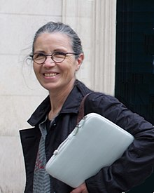
Lattice represents a Universal Data Type
Patrick Cousot
Radhia Cousot
Source of Text : https://www.di.ens.fr/~cousot/publications.www/CousotCousot-POPL-77-ACM-p238--252-1977.pdf

Slide 21
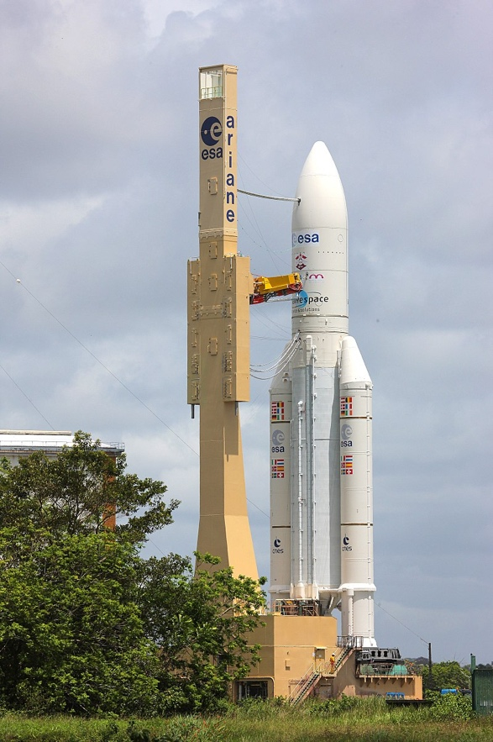
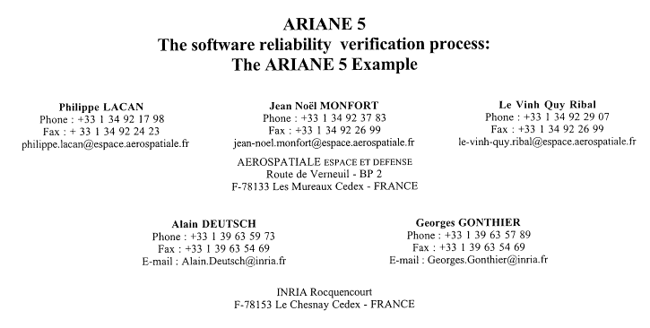
An Example of (not) Computing in Lattice Space
Image Source: Wikipedia

Slide 22
Static Program Analysis using Abstract Interpretation
Arnaud Venet
venet@email.arc.nasa.gov
Guillaume Brat
brat@email.arc.nasa.gov
Kestrel Technology
NASA Ames Research Center
Moffett Field, CA 94035

Slide 23
Static Program Analysis
Static program analysis consists of automatically discovering properties of a program that hold for all possible execution paths of the program.
Static program analysis is not
Testing: manually checking a property for some execution paths
Model checking: automatically checking a property for all execution paths

Slide 24
Program Analysis for what?
Optimizing compilers
Program understanding
Semantic preprocessing:
Model checking
Automated test generation
Program verification

Slide 25
Methodology
Concrete
Semantics
Collecting
Semantics
Tuners
Abstract
Domain
Partitioning
Iterative
Resolution
Algorithms
Abstract
Semantics
Abstract
Domain

Slide 26
Lattices and Fixpoints
A lattice (L, ⊑, ⊥, ⊔, ⊤, ⊓) is a partially ordered set (L, ⊑) with:
Least upper bounds (⊔) and greatest lower bounds (⊔) operators
A least element “bottom”: ⊥
A greatest element “top”: ⊤
L is complete if all least upper bounds exist
A fixpoint X of F: L → L satisfies F(X) = X
We denote by lfp F the least fixpoint if it exists

Slide 27
Fixpoint Theorems
Knaster-Tarski theorem: If F: L → L is monotone and L is a complete lattice, the set of fixpoints of F is also a complete lattice.
Kleene theorem: If F: L → L is monotone, L is a complete lattice and F preserves all least upper bounds then lfp F is the limit of the sequence:
F₀ = ⊥
F_{n+1} = F (F_{n})

Slide 28
Methodology
Concrete
Semantics
Collecting
Semantics
Tuners
Abstract
Domain
Partitioning
Iterative
Resolution
Algorithms
Abstract
Semantics
Abstract
Domain

Slide 29
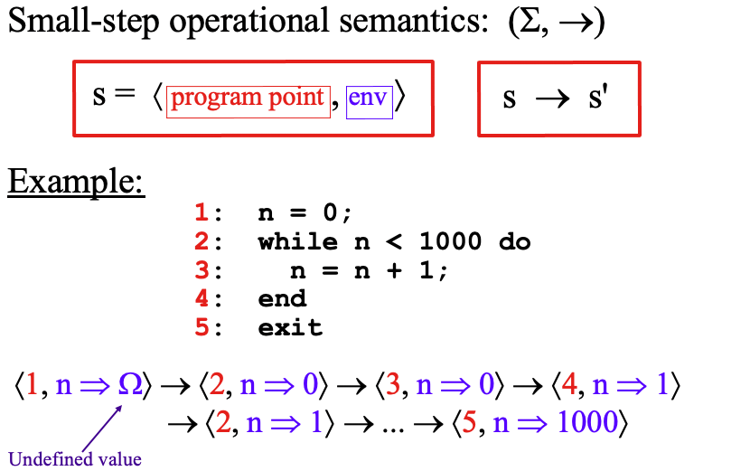
Concrete Semantics

Slide 30
Control Flow Graph
1
1: n = 0;
2: while n < 1000 do
3: n = n + 1;
4: end
5: exit
n = 0
2
n ≥ 1000
n < 1000
3
n = n + 1
4
5

Slide 31
Transition Relation
op
Control flow graph: ⓘ ⓙ
Operational semantics: 〈ⓘ, ε〉 → 〈ⓙ,〚op〛ε 〉
Semantics of op

Slide 32
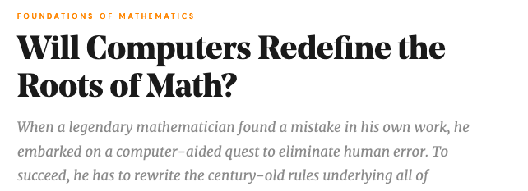
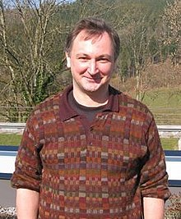

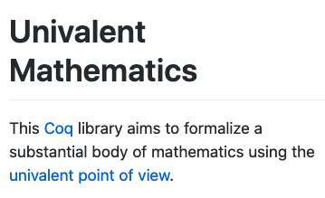

The man who redefined Equal in Math!
By Kevin Hartnett
Vladimir Voevodsky

Slide 33
The cover slide
For the couse on Global Innovation Strategy 2020 Spring
Lists，Tables, Lattices, and Trees
Ben Koo
benkoo@tsinghua.edu.cn
May 12th，2020
Notes:
今天的主题是“区块链启发的新产业范式”

Slide 34
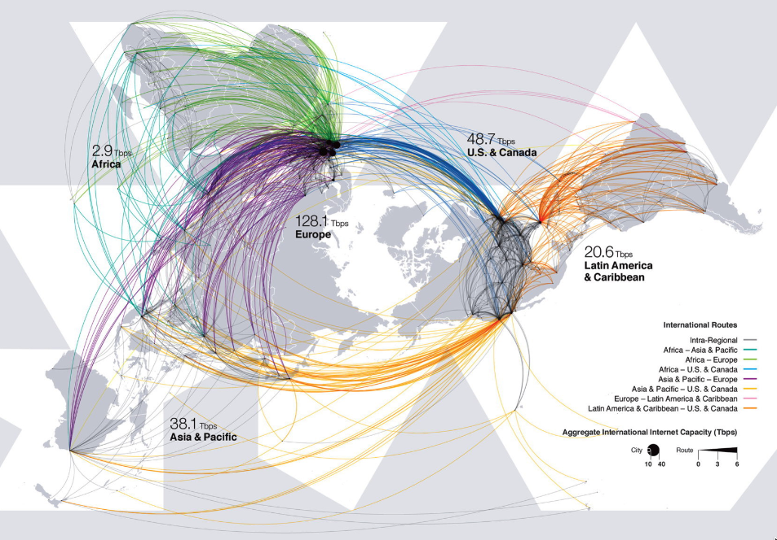

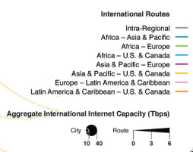
A Scale Free, Boundaryless Cyberspace

Slide 35
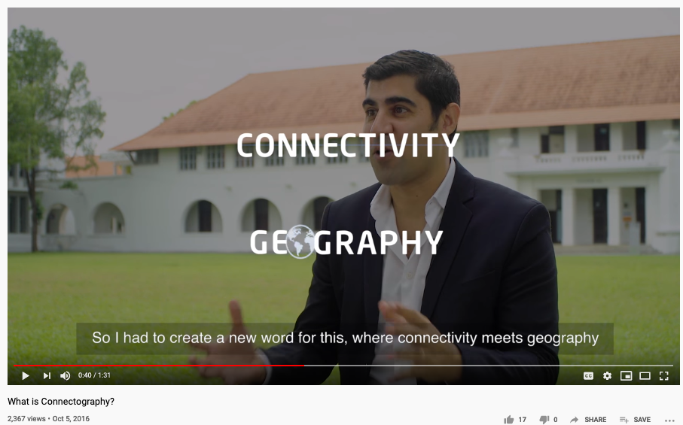
A 2016 Video on the “Future”

Slide 36
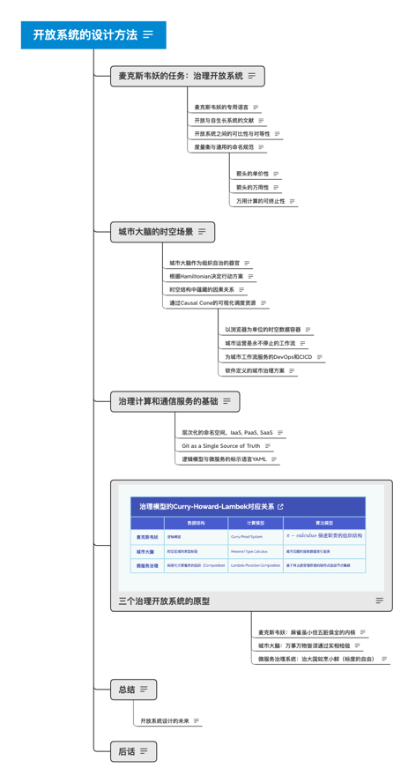
Multi-Lateral in Multi-Scale Context
TRADING UP: ECONOMIC PERSPECTIVES ON DEVELOPMNET ISSUES IN THE MULTILATERAL TRADING SYSTEM – ISBN-92-64-02559-6 © OECD 2006

Slide 37
Environmental Policy Governance
Interlinkages and the effectiveness of multilateral environmental agreements, by W. Bradnee Chambers

Slide 38
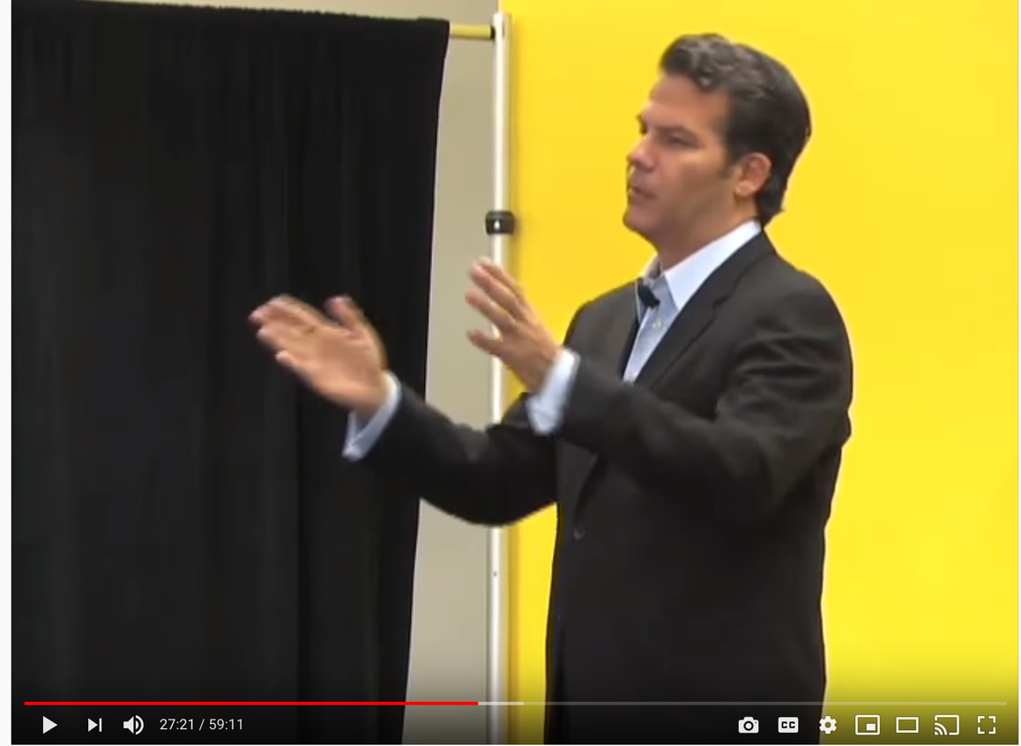
"Who's Your City?" | Talks at Google
https://youtu.be/Cj1OpiBRNsg

Slide 39

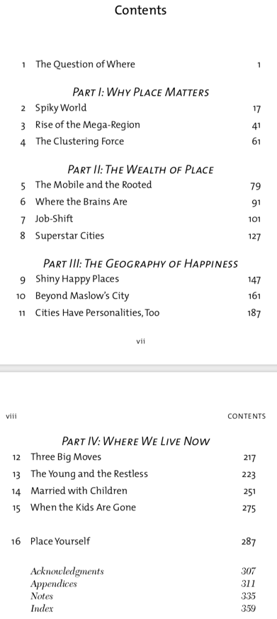
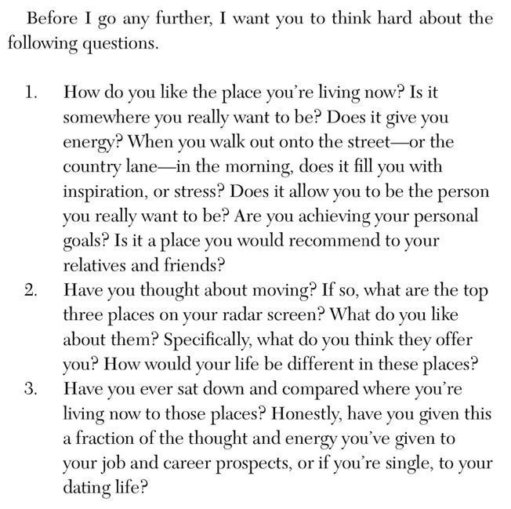
Who's Your City? The most important decision of your life.

Slide 40
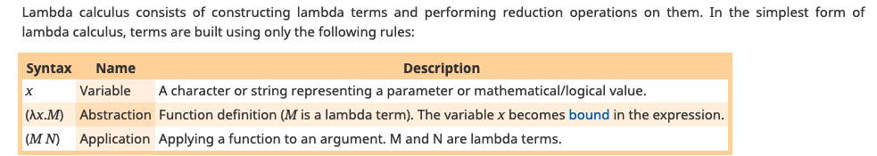

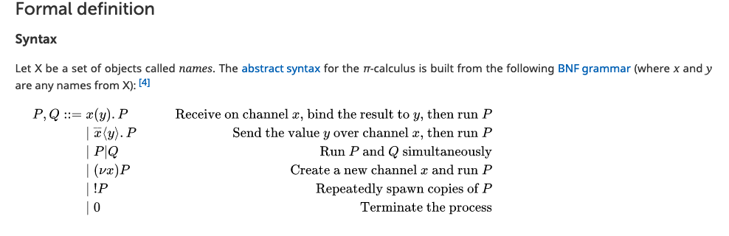
Lambda and Pi-Calculus

Slide 41


How mathematicians and musicians talks about Music
Huawei VP Mr. Yang Shaoqing
RICH 70 Tsinghua SEA Cloud Forum, Sep 14, 2020
H. E. Bambang Brodjonegoro,
Minister of Research & Technology, Indonesia

Slide 42
Conclusion/Summary
Value judgements in terms of Arts, Skills, Talents are subjective:
The subjectivity is bounded in the choice of Languages
Linguistic models exists in many forms, clothing, architecture, choice of residence…
They can be studied and penetrated through Data Science
Data Science cannot be separated from Computation:
Data Structures are always taught with Algorithms that manipulate them.
A unifying view of data+algorithm was already known by Leibniz and Norbert Wiener…

